Slide 1
Database Management System
Munmun Bhattacharya
Dept. of information Technology
Jadavpur University, Salt Lake Campus

Slide 2
Database System
Learning Objective:
At the end of this Topic you will be able to –
  Understand what is a Database System
  Know how files are organized
  Appreciate the advantages of using a DBMS over a traditional file system
  Get some idea of Database Management System
Notes:
First, enter the Topic Name in the slide header.
Second, enter a brief overview on the Topic. The overview can be a combination or any of the following:
Introduction to the Topic
Importance of the Topic
The Topic objectives will contain the list of topic names in bulleted list
For example, in the HTML Module:
The slider header could be:
1.0 Introduction to HTML
The slide content could be:
The Internet is a world-wide network of computers
World Wide Web is the most popular service on the Internet
HyperText Markup Language is used to create the Web pages available on the Internet.
Objective:
After completing this Topic, you will be able to,
Learning the history of Internet
Appreciate the basic HTML tags
Creating a web Page
Slide Instructor’s Notes:
The Internet is a world-wide network of computers. The World Wide Web, often called simply Web, is arguably the most popular service on the Internet. Various pages displayed on the Internet care called Web pages. HyperText Markup Language or HTML is a simple, yet powerful, language made up of tags,. Tags are codes that is inserted into a text to create the elements of a Web page.
After completing this Topic, you will be able to identify the various uses of HTML and list the basic HTML tags.

Slide 3
What is a Database System
A Database System is essentially a computerized record-keeping system.
A database-management system (DBMS) consists of a collection of interrelated data and a set of programs to access those data.
Database systems are designed to manage large volume of information.
Notes:
First, enter the Topic Name in the slide header.
Second, enter a brief overview on the Topic. The overview can be a combination or any of the following:
Introduction to the Topic
Importance of the Topic
The Topic objectives will contain the list of topic names in bulleted list
For example, in the HTML Module:
The slider header could be:
1.0 Introduction to HTML
The slide content could be:
The Internet is a world-wide network of computers
World Wide Web is the most popular service on the Internet
HyperText Markup Language is used to create the Web pages available on the Internet.
Objective:
After completing this Topic, you will be able to,
Learning the history of Internet
Appreciate the basic HTML tags
Creating a web Page
Slide Instructor’s Notes:
The Internet is a world-wide network of computers. The World Wide Web, often called simply Web, is arguably the most popular service on the Internet. Various pages displayed on the Internet care called Web pages. HyperText Markup Language or HTML is a simple, yet powerful, language made up of tags,. Tags are codes that is inserted into a text to create the elements of a Web page.
After completing this Topic, you will be able to identify the various uses of HTML and list the basic HTML tags.

Slide 4
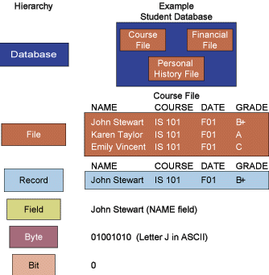
File Organization : Terms and Concepts
Data Hierarchy in a Computer System
Database: Group of related files
File: Group of records of same type
Record: Group of related fields
Field: Group of words or a complete number
Byte: Group of bits that represents a single character
Bit: Smallest unit of data; binary digit (0,1)
Notes:
This is the content slide. Enter the content for the topic in this slide. Ensure that comprehensive speaker notes are available for each slide

Slide 5
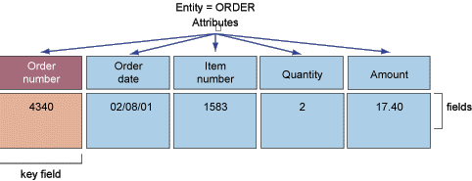
File Organization : Terms and Concepts
Entity: Person, place, thing, event about which information is maintained
Attribute: Description of a particular entity
Key Field: Identifier field used to retrieve, update, sort a record
Notes:
This is the content slide. Enter the content for the topic in this slide. Ensure that comprehensive speaker notes are available for each slide

Slide 6
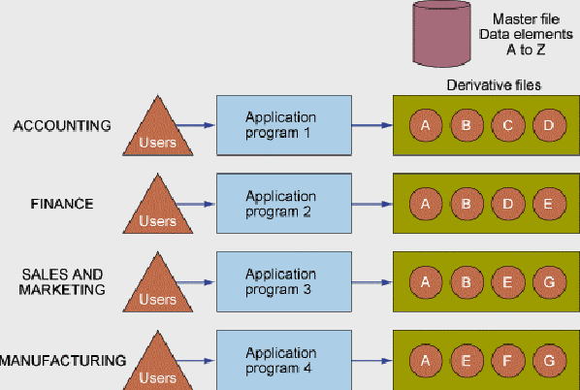
File Organization : Terms and Concepts
Traditional File Processing
Notes:
This is the content slide. Enter the content for the topic in this slide. Ensure that comprehensive speaker notes are available for each slide

Slide 7
Problems with the Traditional File Environment
Data redundancy and inconsistancy
Program-Data dependence
Lack of flexibility
Integrity Problems
Lack of data-sharing and availability
No concurrency control
Poor security

Slide 8
DBMS and its Advantages
A Database Management System is a collection of programs that enables users to create and maintain a database. It is a general purpose software system that facilitates processes of defining, constructing and manipulating databases for various applications.
Advantages of Database approach:
    Controlling Redundancy
    Restricting Unauthorized access
    Providing persistent storage for program objects and data structures
    Providing multiple user interface
    Representing complex relationships among data
    Enforcing integrity constraints and providing backup and recovery

Slide 9
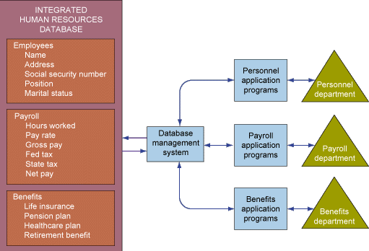
Database Management System (DBMS)
Acts as an interface between the application programs and physical data files.
Separates logical and physical views of data
Eliminates redundancy of data
Creates and maintains databases
Enforces data security
Notes:
This is the content slide. Enter the content for the topic in this slide. Ensure that comprehensive speaker notes are available for each slide

Slide 10
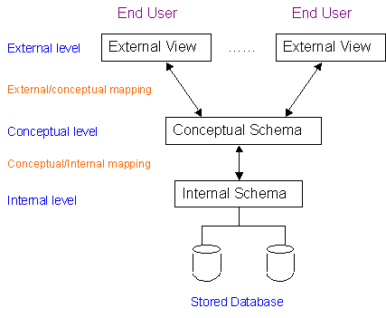
DBMS Architecture
Internal Schema :
Describes physical storage structure of database
Conceptual Schema :
Describes structure of whole database for a community of users.
External Schema :
Each view describes that part of database that a particular user requires, and hides the rest.

Slide 11
DBMS Architecture
Data Independence
  Logical data independence : capacity to change conceptual schema without having to change external schema.
  Physical data independence : capacity to change internal schema without changing conceptual schema.

Slide 12
Functions of DBMS
Data definition: Specifies content and structure of database and defines each data element
Data manipulation: Manipulates data in a database
Data security and integrity: Monitors user requests and rejects any unauthorized attempts
Data recovery and concurrency: Enforces certain controls for recovery and concurrency
Data dictionary: Stores definitions of data elements, and data characteristics
Performance: Functions should be performed efficiently
Notes:
This is the content slide. Enter the content for the topic in this slide. Ensure that comprehensive speaker notes are available for each slide.

Slide 13
Types of Databases
Learning Objective:
At the end of this Topic you will be able to explain briefly the various types of Database Systems
    Relational DBMS
    Hierarchical DBMS
    Network DBMS
    Object-Oriented Databases

Slide 14
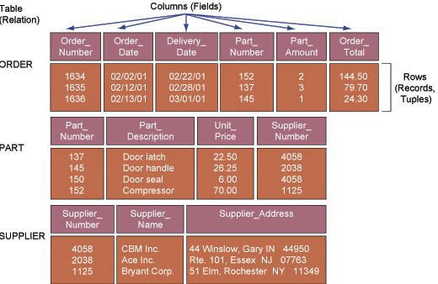
Relational Database Model
Represents data as two-dimensional tables called relations
Relates data across tables based on common data element
      Examples: DB2, Oracle, MS SQL Server

Slide 15
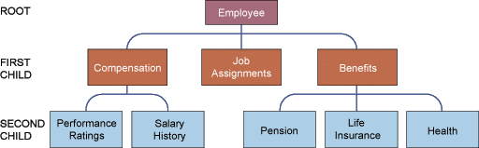
Hierarchical Database Model
It is a pointer based model
Organizes data in a tree-like structure
Stores data in tables and views relationships as links
Supports one-to-many parent-child relationships
Prevalent in large legacy systems

Slide 16

Network DBMS
Depicts data logically as many-to-many relationships
Organizes data in tables and views relationships as links
It is also a pointer based model
Organizes data in arbitrary graphs

Slide 17
Hierarchical and Network DBMS
Some of the Disadvantages
Outdated
Complex pointer based organization
Less flexible compared to RDBMS
Lack support for ad-hoc and English language-like queries

Slide 18
Object-Oriented Databases
Object-oriented DBMS: Stores data and procedures as objects that can be retrieved and shared automatically
Object-relational DBMS: Provides capabilities of both object-oriented and relational DBMS

Slide 19
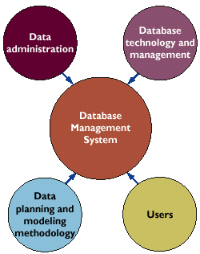
Requirements of a DBMS
Key elements in a database environment:
Data Administration
Data Planning and Modeling Methodology
Database Technology and Management
Users

Slide 20
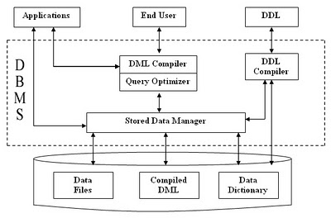
Structure of DBMS

Slide 21
Different Types of Database Users
Database Administrator
The person having the central control of both data and programs accessing that data (over the system) is called DBA.

Slide 22
Functions of DBA
Schema definition
Storage structure and access method definition
Schema and physical structure modification
Granting for authorization for data access
Integrity constraint specification
Data availability and recovery from failures
Database tuning

Slide 23
End Users
Casual: Occasional users; middle level or high level managers
Naive: Constantly querying or updating the database
Sophisticated : Implement their application to meet their complex requirement
System Analyst : Determine requirements and develop specification
Application Programmer : Implement specification

Slide 24
Database Manager
A DBM is a program module which provides the interface between the low-level data stored in the database and the application programs and queries submitted to the system

Slide 25
Function of DBM
Interaction with the file manager
Integrity enforcement
Security enforcement
Backup and recovery
Concurrency control

